Slide 1



CO-PILOT: Dynamic Top-Down Point Cloud with Conditional Neighborhood Aggregation for Multi-Gigapixel Histopathology Image Representation
Ramin Nakhli, Allen Zhang, Ali Mirabadi, Katherine Rich,
Maryam Asadi, Blake Gilks, Hossein Farahani*, Ali Bashashati*
Published in: International Conference on Computer Vision (ICCV)（2023）
Saif Ur Rehman Khan
Notes:
这篇文章提出了一种强化学习(RL)智能体，强化因果解释器(RC-Explainer)，以实现因果筛选策略。

Slide 2
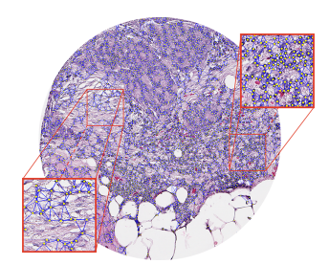
1
Introduction
Representation Learning are popular
Cellular heterogeneity
Histopathology image：Spatial Positioning, and Mutual interactions, matching ...
Deep Learning
The utilization of deep learning models in the digital processing of medical images has gained interest in the computer vision community, particularly in tasks such as classification, segmentation, and survival prediction.
Multiple Instance Learning (MIL) techniques are commonly used for training deep learning models on histopathology images, where the images are divided into smaller patches and aggregated to represent the whole slide.
limitations in terms of representational capacity computational power, and focusing on patches rather than individual cells
Fig 1: Cellular graph constructed by connecting the adjacent nodes within a 4, 000 × 4, 000 pixels image
自强不息 厚德载物
Central South University
Notes:
The study highlights the importance of cellular heterogeneity, spatial positioning, and mutual interactions in histopathology image representation learning.
Previous works have limitations in terms of representational capacity, computational power, and focusing on patches rather than individual cells, while CO-PILOT addresses these issues.
Extensive ablation experiments validate the design choices of the model, including the importance of low-, mid-, and high-level blocks, as well as the superiority of the conditional neighborhood aggregation (CNA) layer.
The model is validated using two tissue microarray (TMA) datasets from high-grade serous ovarian cancer, as well as the publicly available ovarian TCGA dataset.

Slide 3
1
Former Approach Problems and Motivation
Former MIL Approach Limitation
MIL techniques have limitations in terms of representational capacity and capturing high-granular details in histopathology images.
MIL models fail to account for the individual cells present in each patch, which are fundamental for understanding the tissue.
MIL techniques divide the whole slide image into smaller patches and aggregate the patch embeddings, which may result in the loss of important cell-level information.
MIL models may not fully capture the cellular heterogeneity, spatial positioning, and mutual interactions that are crucial for accurate histopathology image representation learning.
Contributions
The approach involves developing CO-PILOT, a novel dynamic and hierarchical point-cloud-based method for processing cellular graphs extracted from histopathology images.
Fig 1: Cellular graph constructed by connecting the adjacent nodes within a 4, 000 × 4, 000 pixels image
自强不息 厚德载物
Central South University

Slide 4
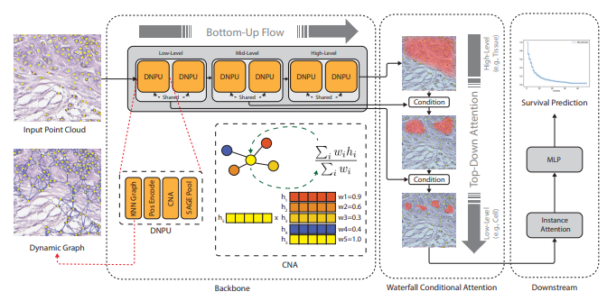
CO-PILOT Architecture
3
To capture this hierarchy effectively, the design utilizes:
Dynamic graph construction.
Neighborhood message passing operations.
Hierarchical node pooling mechanism.
Each DNPU (Dynamic Node Processing Unit) consists of four consecutive sub-modules.
Fig 2: Dynamic Top-Down Point Cloud with Conditional Neighborhood Aggregation for Multi-Gigapixel Histopathology Image Representation
自强不息 厚德载物
Notes:
Histopathology tissue samples have a complex hierarchical structure.
The structure involves interactions between cells and their neighbors at a local level.
It also encompasses interactions between different tissue types at a larger scale.

Slide 5
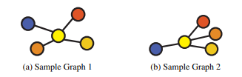
Sub-Modules
3
Graph Construction
This layer's primary function is to create a graph from input nodes, representing points in the cloud.
It achieves this by establishing connections between each node and its K nearest neighbors.
The dynamic construction process ensures continuous information flow across different hierarchical levels, preventing node isolation in the graph.
Additionally, a self-loop is added to each node during this step.
Fig 3: Different positioning of nodes in graphs. Even though these two graphs have different node positioning, they are represented in the same way by the conventional graph neural networks. Using a relative positional encoding, CO-PILOT is able to address this issue.
Position Encoding
It encodes the spatial positioning of neighboring elements..
They use permutation-invariant operations.
These operations are applied regardless of node positional arrangement.
While this is advantageous for certain types of graphs like social networks,
It can significantly impact the interpretation of cellular graphs.
自强不息 厚德载物
Central South University

Slide 6
Sub-Modules
3
Conditional Neighborhood Aggregation
The composition of the neighborhood, especially the types of cells present, plays a vital role in determining tissue characteristics.
Graph neural networks incorporate this information through message-passing operations but operate unconditionally relative to the current node.
This unconditional approach can result in overly smoothed representations and reduced performance.
CNA aggregates the representations of neighboring nodes based on the current node's information, addressing the over-smoothing issue.
Fig 1: Cellular graph constructed by
connecting the adjacent nodes within
a 4, 000 × 4, 000 pixels image
自强不息 厚德载物
Central South University

Slide 7
Sub-Modules
3
Waterfall Attention
Downstream tasks typically utilize processed representations from the final layer of a network.
This approach relies on high-level representations generated through bottom-up information propagation.
However, there is a hypothesis that lower-level features could offer valuable insights when conditioned on high-level features.
For Clinical studies, support the idea that cellular statistics can predict therapeutic response when categorized by tissue types.
To test this hypothesis, a top-down attention aggregation module called "Waterfall Attention" is develop.
Fig 1: Cellular graph constructed by
connecting the adjacent nodes within
a 4, 000 × 4, 000 pixels image
自强不息 厚德载物
Central South University

Slide 8
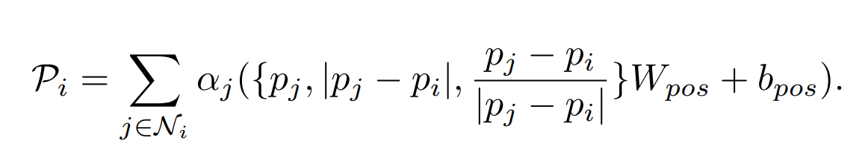
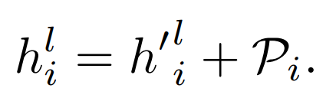
Methodology
5
1
CO-PILOT utilizes a framework consisting of Dynamic Neighborhood Processing Units (DNPUs) grouped in pairs to form three main blocks for low-, mid-, and high-level feature processing.
PE: Position Encoding enables to attend to both the density and geometry of the neighborhood.
Position Encoding:
given a node feature of for node i at layer l, the positional encoding aggregation (reduce parameter)
PE handle interpretation effect of permutation invariant operation by node computation of its Cartesian coordinate
Ni is the set of nodes connected to node i in the graph, Wpos ∈ R 5×d and bpos ∈ R 1×d are learnable matrices, d is the embedding dimension of node features, and αj is the normalized attention weight obtained by a linear layer.
自强不息 厚德载物
Central South University

Slide 9
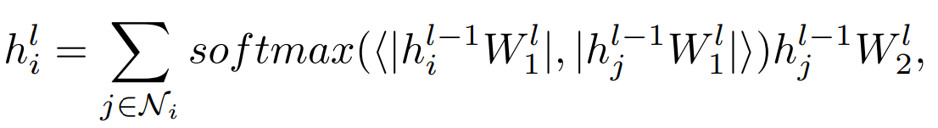
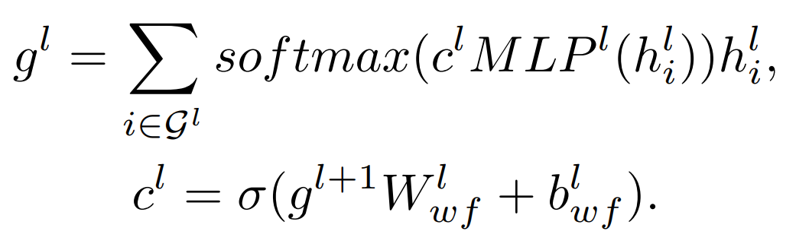
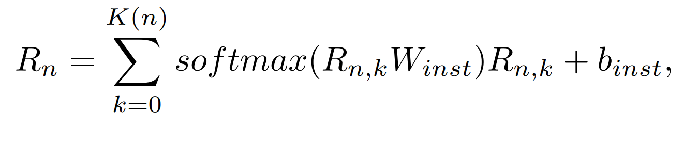
Methodology
5
Integrate the arrangement of the nodes into the graph representation.
CAN: Handle over-smoothing of the representation by Aggregates the representations of neighboring nodes given that of the current node.
CNA
Nj is the collection of nodes in graph at layer l
Waterfall Attention
Hypothesize that the lower-level features could potentially reveal more valuable information if they were conditioned on the high-level features.
Top-Down Aggregation
Instance Attention
Combine embeddings from different images belonging to the same patient
Loss Function: Negative Log Likelihood (NLL)
自强不息 厚德载物
Central South University
Notes:
where h l i is the representation of node i at layer l, Nj is the collection of nodes connected to the node i in the graph at layer l, Wl 1 and Wl 2 ∈ R d×d are learnable matrices, |.| is the second order norm, and ⟨.⟩ is the inner product.
n this equation, g l ∈ R 1×d is the aggregated representation of the graph at layer l, G l is the collection of nodes in the graph at layer l, h l i is the representation of node i at layer l, Wl wf ∈ R d×1 and bwf ∈ R are learnable parameters, and MLPl is a two-layer MLP with hidden size of d and output size of 1. To calculate g L−1 , where L is the total number of DNPU layers, we set the c L−1 i to 1 which is equivalent to an unconditional aggregation at the last layer. Finally, the aggregated g 0 (equivalent to Rn,k mentioned in Sec. 3.2) is fed into an instance attention to combine all of the image representations for the patient.
where Rn,k is the corresponding representation of xn,k obtained from the Waterfall attention, while Winst ∈ Rd×1 and binst ∈ R are learnable parameters. Finally, Rn is passed through a fully connected layer to generate the hazard, and the network is trained using the Negative Log Likelihood (NLL) loss.

Slide 10
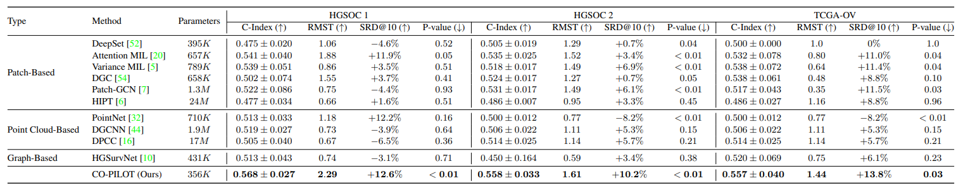
Experiments Results
6
Results indicate that the cellular graph alone captures enough information to surpass the patch-based methods, implying the model’s potential to deduce the micro-environment structure from the cellular graph.
Table 1: Survival prediction performance comparison of CO-PILOT model with all the baselines on two datasets.
Proposed Model achieves a c-index of 0.568, 0.558, and 0.557 on the HGSOC 1, HGSOC 2, and TCGA-OV datasets while those of the closest baselines are 0.541, 0.535, and 0.532.
Evaluation Metrics
C-index: Consistency between predicted and actual survival times
RMST: Ratio of the area under the survival curves of the low- and high-risk cohorts
SRD: Calculated by subtracting the 10-year survival rate of the high-risk cohort from that of the low-risk.
自强不息 厚德载物
Central South University

Slide 11
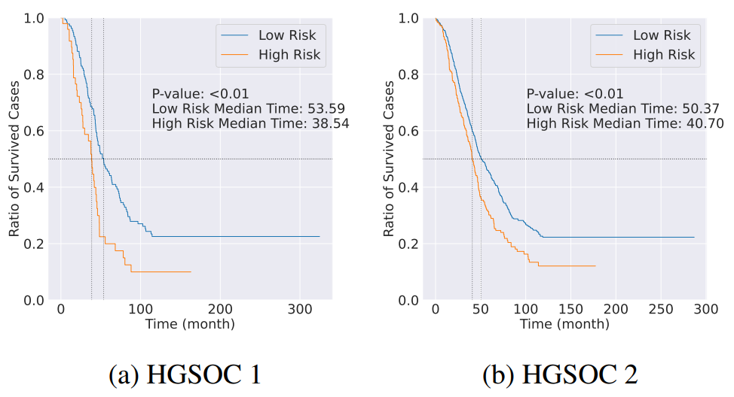
Experiments
6
Fig 4: Survival curves for cohorts of patients identified as low-risk (predicted hazard < hazard threshold) and high-risk (prediction hazard > hazard threshold) by our model. Our model can predict patients who have significantly higher risks and shorter survival times.
自强不息 厚德载物
Central South University
Notes:
The model successfully separates low- and high-risk patients on both datasets.
It achieves this separation uniquely on the HGSOC 1 dataset.
This study is the first to demonstrate the feasibility of such separation among high-grade serous ovarian cancer (HGSOC) patients solely using routine H&E images.
While the C-index is a common metric for survival prediction model comparison, the clinical utility lies in stratifying patients into outcome-based groups.
Patient groups with statistically significant differences in outcomes can be managed differently in clinical practice.
Kaplan-Meier (KM) curves and log-rank test p-values are essential tools for evaluating patient stratification.
The model effectively stratifies patients into low- and high-risk groups, with high-risk patients experiencing significantly shorter survival times.
For instance, in the HGSOC 1 dataset, high-risk patients had median survival times of 38.5 months, whereas low-risk patients had 53.6 months.
Similarly, in the HGSOC 2 dataset, high-risk patients had median survival times of 40.7 months, while low-risk patients had 50.4 months.

Slide 12
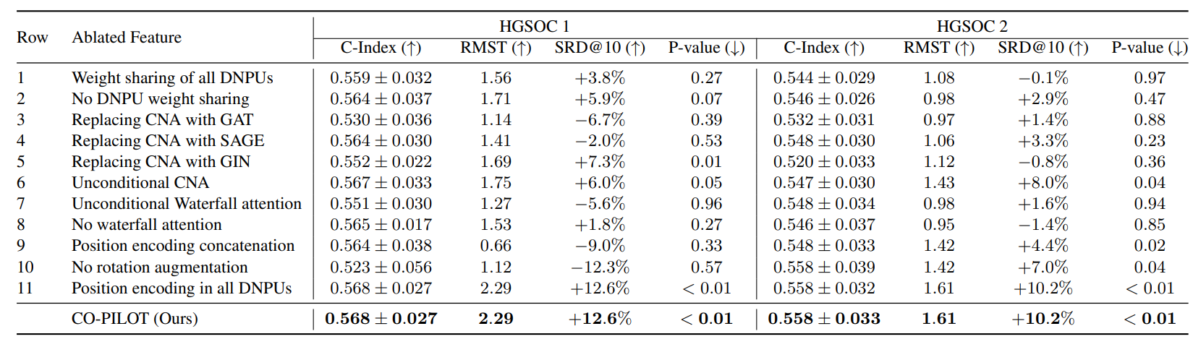
Ablation Study
6
Table 2. Ablation studies of our model on both datasets.
自强不息 厚德载物
Central South University

Slide 13
Contribution
4
A dynamic and hierarchical point-cloud-based method for processing cellular graphs from histopathology images, outperforming state-of-the-art methods in survival prediction.
Utilizes bottom-up information propagation and top-down conditional attention to adaptively focus on different levels of tissue hierarchy, capturing finer details and individual cells in each patch.
Stratifies patients into different risk cohorts with statistically different outcomes, a task previously achievable only using genomic information.
Publishes a large dataset containing 873 cellular graphs from 188 patients, along with their survival information, making it one of the largest publicly available datasets in this context.
Advances the frontiers of Multiple Instance Learning (MIL), Vision Transformer (ViT), and Graph Neural Networks (GNNs) in histopathology image representation learning .
自强不息 厚德载物
Central South University

Slide 14
Conclusion
7
CO-PILOT, outperforms existing patch-based survival prediction methods, including the Hierarchical Vision Transformer, demonstrating its potential in deducing tissue environment from cellular graphs .
CO-PILOT can stratify high-grade cancer patients into low- and high-risk cohorts using routine (H&E)-stained tissue slides, a task previously requiring global genomic and transcriptomics profiles or immunohistochemistry images.
CO-PILOT's performance improvement is consistent across different datasets and metrics, achieving higher C-index, log-rank p-value, restricted mean survival time (RMST), and survival rate difference (SRD) compared to baselines.
Fig 2: Dynamic Top-Down Point Cloud with Conditional Neighborhood Aggregation for Multi-Gigapixel Histopathology Image Representation
自强不息 厚德载物
Central South University

Slide 15
THANKS FOR ALL
CO-PILOT: Dynamic Top-Down Point Cloud with Conditional Neighborhood Aggregation for Multi-Gigapixel Histopathology Image Representation
Ramin Nakhli, Allen Zhang, Ali Mirabadi, Katherine Rich,
Maryam Asadi, Blake Gilks, Hossein Farahani*, Ali Bashashati*
Published in: International Conference on Computer Vision (ICCV)（2023）
Saif Ur Rehman Khan

